Slide 2
Operating System II CMP 321 Introduction
Egena Onu, PhD.
Computer Science Department,
Bingham University.

Slide 3
Course Content
Concurrency.
Process States and State Diagrams.
Dispatching and context switching interrupts.
Concurrent execution, mutual exclusion problem and some solution deadlock.
Model and mechanism (semaphores, monitors, etc).
Scheduling and dispatching:
Memory management.
Overlays, swapping and partitions.
Paging segmentations.
Placement policies.
Working sets, trashing and caching.
Producers:
Consumer problem.
Synchronisation multiprocessor issues.
Practical:
BASH shell scripting.
Notes:
Concurrency: States and State diagram Structures, Dispatching and context switching; interrupts; Concurrent execution; mutual exclusion problem and some solution Deadlock; Models and mechanisms (Semaphores, monitors etc.). Producer – consumer Problems & Synchronization, P & V operations, resource protection. Multiprocessor issues. Scheduling & dispatching, Memory Management: Overlays, Swapping and Partitions, Paging and Segmentation Placement & replacement policies, working sets and Trashing, caching.

Slide 4
Delivery
Total Contact Hour: 45
Exam: 60%
Tests: 30%
Attendance (80%): 10%

Slide 5
Concurrency
Concurrency is the execution of the multiple instruction sequences at the same time.
In the operating system, concurrency occurs when there are several process threads running in parallel.
The running process threads always communicate with each other through shared memory or message passing.
Concurrency results in sharing of resources result in problems like deadlocks and resources starvation.
Concurrency helps in techniques like coordinating execution of processes, memory allocation and execution scheduling for maximizing throughput.

Slide 6
Problems with Concurrency
Interleaved and overlapping processes are two types of concurrent processes with the same problems.
It is impossible to predict the relative speed of execution, and the following factors determine it:
The way operating system handles interrupts
Other processes' activities
The operating system's scheduling policies
Notes:
Today's technologies like multi-core processors and parallel processing, allow multiple processes and threads to be executed simultaneously. Multiple processes and threads can access the same memory space, the same declared variable in code, or even read or write to the same file.
The amount of time it takes a process to execute cannot be simply estimated, and you cannot predict which process will complete first, enabling you to build techniques to deal with the problems that concurrency creates.

Slide 7
Problems with Concurrency
Locating the programming errors
It's difficult to spot a programming error because reports are usually repeatable due to the varying states of shared components each time the code is executed.
Sharing Global Resources
Sharing global resources is difficult. If two processes utilize a global variable and both alter the variable's value, the order in which the many changes are executed is critical.

Slide 8
Problems with Concurrency
Locking the channel
It could be inefficient for the OS to lock the resource and prevent other processes from using it.
Optimal Allocation of Resources
It is challenging for the OS to handle resource allocation properly.

Slide 9
Issues of Concurrency
Non-atomic
A non-atomic operation depends on other processes, and an atomic operation runs independently of other processes.
Operations that are non-atomic but interruptible by several processes may happen issues.

Slide 10
Issues of Concurrency
Deadlock
In concurrent computing, it occurs when one group member waits for another member, including itself, to send a message and release a lock.
Software and hardware locks are commonly used to arbitrate shared resources and implement process synchronization in parallel computing, distributed systems, and multiprocessing.

Slide 11
Issues of Concurrency
Blocking
A blocked process is waiting for some event, like the availability of a resource or completing an I/O operation.
Processes may block waiting for resources, and a process may be blocked for a long time waiting for terminal input.
If the process is needed to update some data periodically, it will be very undesirable.

Slide 12
Issues of Concurrency
Race Conditions
A race problem occurs when the output of a software application is determined by the timing or sequencing of other uncontrollable events.
Race situations can also happen in multithreaded software, runs in a distributed environment, or is interdependent on shared resources.

Slide 13
Issues of Concurrency
Starvation
A problem in concurrent computing is where a process is continuously denied the resources it needs to complete its work.
It could be caused by errors in scheduling or mutual exclusion algorithm, but resource leaks may also cause it.
Concurrent system design frequently requires developing dependable strategies for coordinating their execution, data interchange, memory allocation, and execution schedule to decrease response time and maximize throughput.

Slide 14
Advantages of Concurrency
Better Performance.
Better Resource Utilisation
Running Multiple Applications
Notes:
1. Better Performance
It improves the operating system's performance. When one application only utilizes the processor, and another only uses the disk drive, the time it takes to perform both apps simultaneously is less than the time it takes to run them sequentially.
2. Better Resource Utilisation
It enables resources that are not being used by one application to be used by another.
3. Running Multiple Applications
It enables you to execute multiple applications simultaneously.

Slide 15
Disadvantages of Concurrency
It is necessary to protect multiple applications from each other.
It is necessary to use extra techniques to coordinate several applications.
Additional performance overheads and complexities in OS are needed for switching between applications.

Slide 16
Components of Modern OS
Processes
Memory Management
Information Protection and Security
Scheduling and Resource Management

Slide 17
Process
A process can be defined as:
A program in execution.
An instance of a running program.
The entity that can be assigned to, and executed on a processor.
A unit of activity characterised by a single sequential thread of execution, a current state, and an associated set of system resources.

Slide 18
Operations on the Process
There are four operations performed on a process:
Creation
Scheduling
Execution
Deletion/killing
Notes:
1. Creation
Once the process is created, it will be ready and come into the ready queue (main memory) and will be ready for the execution.
2. Scheduling
Out of the many processes present in the ready queue, the Operating system chooses one process and start executing it. Selecting the process which is to be executed next, is known as scheduling.
3. Execution
Once the process is scheduled for the execution, the processor starts executing it. Process may come to the blocked or wait state during the execution then in that case the processor starts executing the other processes.
4. Deletion/killing
Once the purpose of the process gets over then the OS will kill the process. The Context of the process (PCB) will be deleted and the process gets terminated by the Operating system.

Slide 19
Components of a Process
A process contains three components:
An executable program.
The associated data needed by the program:
Variables
Workspace
Buffers, etc.
The execution context (or process state) of the program.

Slide 20
Components of a Process
Execution Context:
Is the internal data by which the OS is able to supervise and control the process.
Includes the contents of the various process registers.
Includes information such as the priority of the process and whether the process is waiting for the completion of a particular I/O event.

Slide 21
Process Elements
There are two essential elements of a process:
Program code.
May be share with other processes that are executing the same program.
A set of data associated with the code.
When the processor begins to execute the program code, the executing entity is referred to as the process.

Slide 22
Process Elements
While a program is executing, the process can be uniquely characterised by a number of elements:
Identifier
State
Priority
Program Counter
Memory Pointer
Context Data
I/O Status Information
Accounting Information

Slide 23
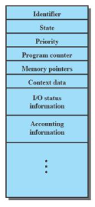
Process Control Block
Contains the process elements.
Makes it possible to interrupt a running process and later resume execution as though there had not been an interruption.
Created and managed by the OS.
Key tool that allows support for multiple processes (multiprogramming).

Slide 25
Process State and State Diagrams
When a process is executed (from its creation to completion), it changes the state,
Generally the state of process is determined by the current activity of the process.
At any point, a process may be in one state.
The minimum number of states is five.

Slide 26
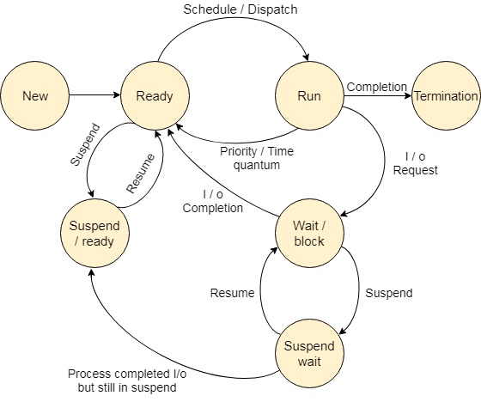
Process State and State Diagrams

Slide 27
Process State and State Diagrams
The names of the states are not standardized although the process may be in one of the following states during execution.
New
Ready
Running
Block or wait
Completion or termination
Suspend ready
Suspend wait
Notes:
The names of the states are not standardized although the process may be in one of the following states during execution.
1. New
A program which is going to be picked up by the OS into the main memory is called a new process.
2. Ready
Whenever a process is created, it directly enters in the ready state, in which, it waits for the CPU to be assigned. The OS picks the new processes from the secondary memory and put all of them in the main memory.
The processes which are ready for the execution and reside in the main memory are called ready state processes. There can be many processes present in the ready state.
3. Running
One of the processes from the ready state will be chosen by the OS depending upon the scheduling algorithm. Hence, if we have only one CPU in our system, the number of running processes for a particular time will always be one. If we have n processors in the system then we can have n processes running simultaneously.
4. Block or wait
From the Running state, a process can make the transition to the block or wait state depending upon the scheduling algorithm or the intrinsic behavior of the process.
When a process waits for a certain resource to be assigned or for the input from the user then the OS move this process to the block or wait state and assigns the CPU to the other processes.
5. Completion or termination
When a process finishes its execution, it comes in the termination state. All the context of the process (Process Control Block) will also be deleted the process will be terminated by the Operating system.
6. Suspend ready
A process in the ready state, which is moved to secondary memory from the main memory due to lack of the resources (mainly primary memory) is called in the suspend ready state.
If the main memory is full and a higher priority process comes for the execution then the OS have to make the room for the process in the main memory by throwing the lower priority process out into the secondary memory. The suspend ready processes remain in the secondary memory until the main memory gets available.
7. Suspend wait
Instead of removing the process from the ready queue, it's better to remove the blocked process which is waiting for some resources in the main memory. Since it is already waiting for some resource to get available hence it is better if it waits in the secondary memory and make room for the higher priority process. These processes complete their execution once the main memory gets available and their wait is finished.

Slide 28
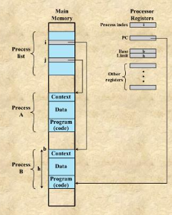
Process Management
The entire state of the process at any instance is contained in its context.
New features can be designed and implemented into the OS by expanding the context to include any new information needed to support the feature.

Slide 29
Question!!!

